Slide 1
Arrays: computing with many numbers

Slide 2
Some perspective
We have so far (mostly) looked at what we can do with single numbers (and functions that return single numbers).
Things can get much more interesting once we allow not just one, but many numbers together.
It is natural to view an array of numbers as one object with its own rules.
The simplest such set of rules is that of a vector.
Demo “Sound as Vectors”

Slide 3
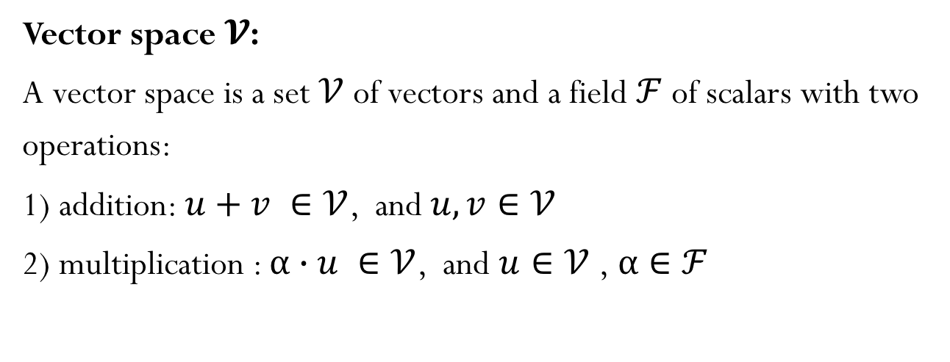
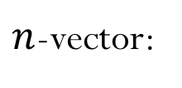
Vectors
A vector is an element of a Vector Space
$n$-vector:
Vector space $𝓥$:
A vector space is a set $𝒱$ of vectors and a field $ℱ$of scalars with two operations:
1) addition: $u+v ∈𝒱$, and $u,v∈𝒱$
2) multiplication : $α∙u ∈𝒱$, and $u∈𝒱$ ,$α∈ℱ$

Slide 4
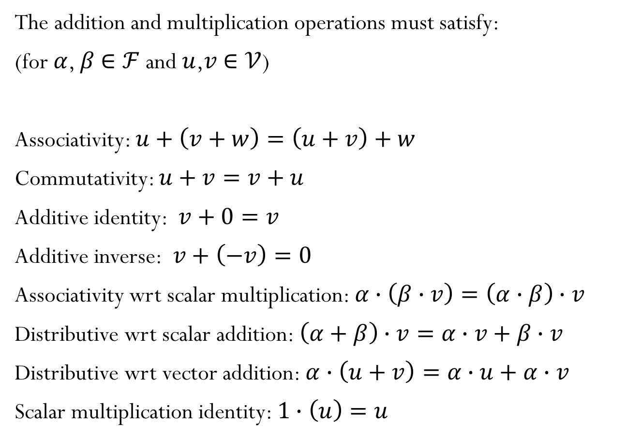
Vector Space
The addition and multiplication operations must satisfy:
(for $α$, $β$ $∈ℱ$and $u$,$v$ $∈𝒱$)
Associativity: $u+\left(v+w\right)=\left(u+v\right)+w$
Commutativity: $u+v=v+u$
Additive identity: $v+0=v$
Additive inverse: $v+\left(−v\right)=0$
Associativity wrt scalar multiplication: $α∙\left(β∙v\right)=\left(α∙β\right)∙v$
Distributive wrt scalar addition: $\left(α+β\right)∙v=α∙v+β∙v$
Distributive wrt vector addition: $α∙\left(u+v\right)=α∙u+α∙v$
Scalar multiplication identity: $1∙\left(u\right)=u$

Slide 5
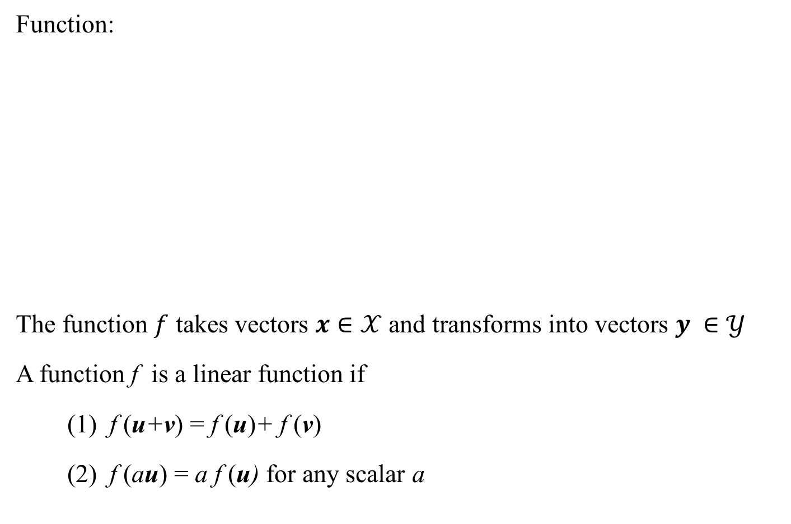
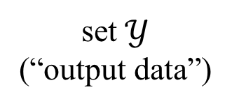
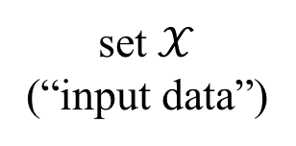
Linear Functions
Function:
The function $f$ takes vectors $x∈𝒳$ and transforms into vectors $y ∈𝒴$
A function f is a linear function if
(1) f (u+v) = f (u)+ f (v)
(2) f (au) = a f (u) for any scalar a
set $𝒳$
(“input data”)
set $𝒴$
(“output data”)

Slide 6
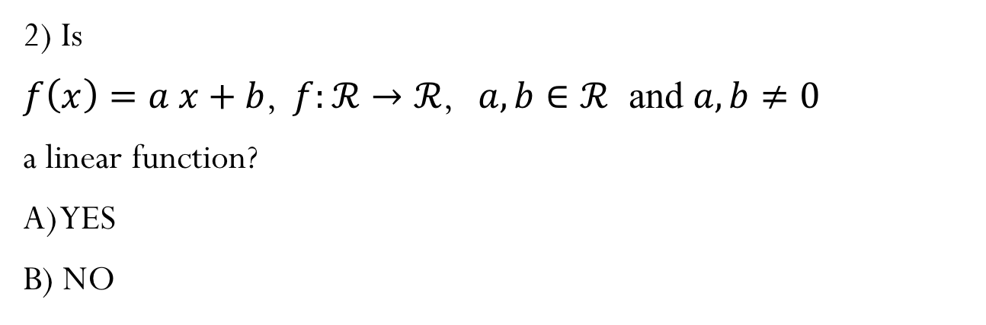
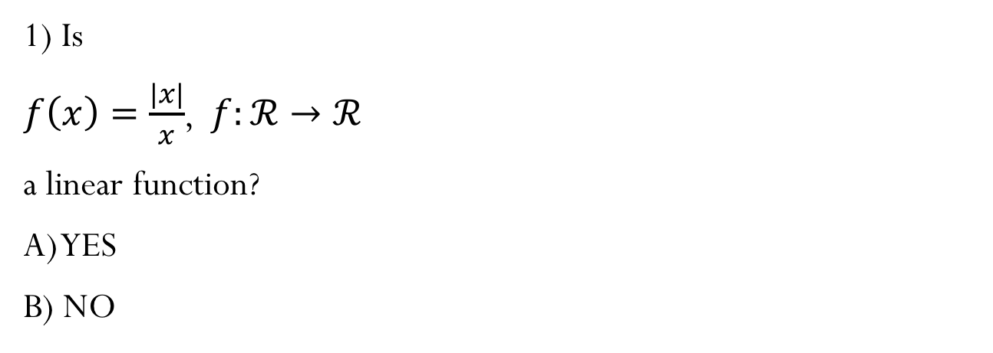
Iclicker question
1) Is
$f\left(x\right)=\frac{|x|}{x}$, $f:ℛ→ℛ$
a linear function?
A) YES
B) NO
2) Is
$f\left(x\right)=a x+b$, $f:ℛ→ℛ$, $a,b∈ℛ$ and $a,b≠0$
a linear function?
A) YES
B) NO

Slide 7
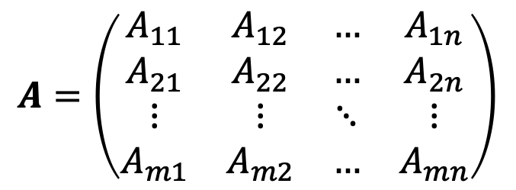
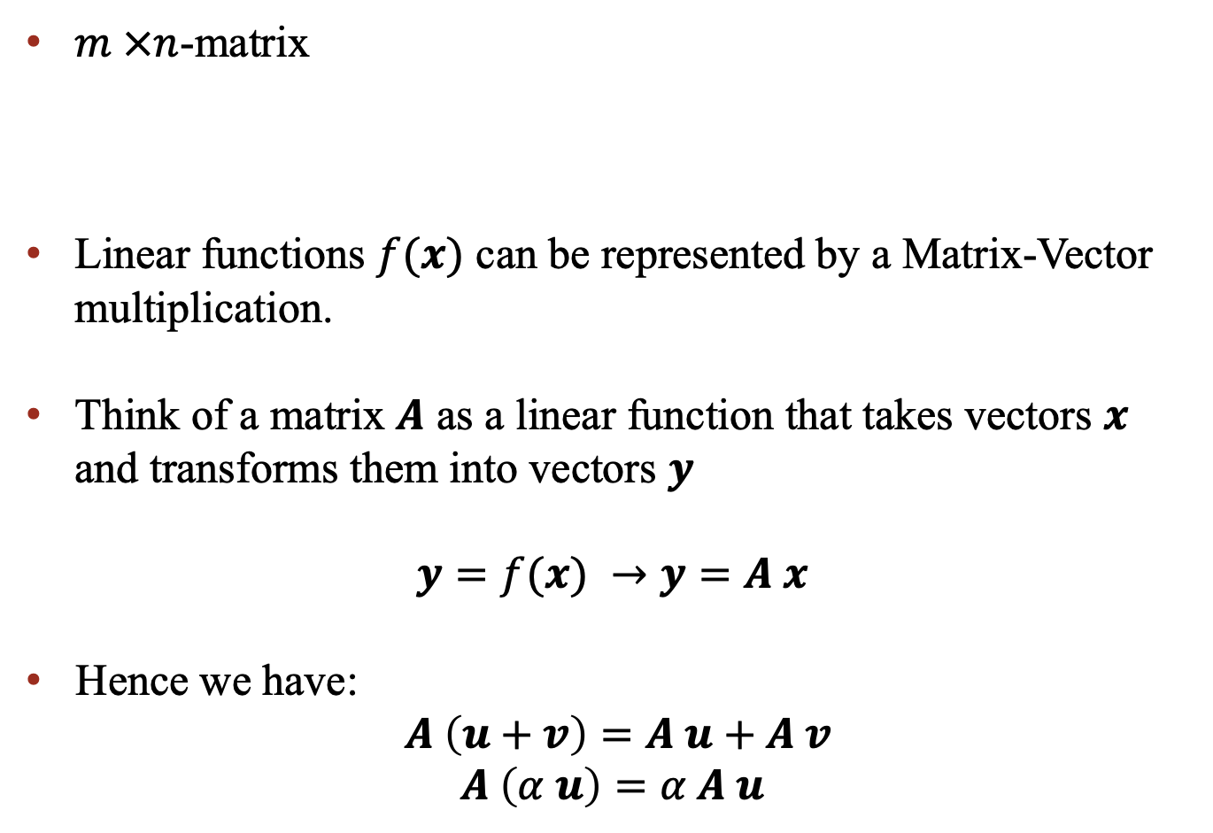
Matrices
$$A=\left(\begin{matrix}A_{11} & A_{12} & … & A_{1n} \\ A_{21} & A_{22} & … & A_{2n} \\ ⋮ & ⋮ & ⋱ & ⋮ \\ A_{m1} & A_{m2} & … & A_{mn}\end{matrix}\right)$$
$m ×n$-matrix
Linear functions $f(x)$ can be represented by a Matrix-Vector multiplication.
Think of a matrix $A$ as a linear function that takes vectors $x$ and transforms them into vectors $y$
$y=f(x)$ $→y=A x$
Hence we have:
$A \left(u+v\right)=A u+A v$
$$A \left(α u\right)=α A u$$

Slide 8
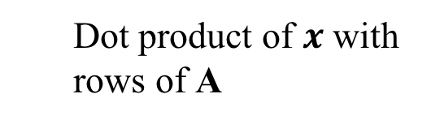
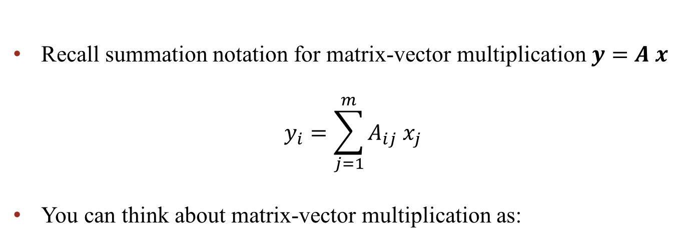
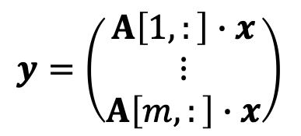
Matrix-Vector multiplication
Recall summation notation for matrix-vector multiplication $y=A x$
You can think about matrix-vector multiplication as:
Linear combination of column vectors of A
$$y={ x}_{1} A\left[:,1\right]+{ x}_{2} A\left[:,2\right]+…+{ x}_{n} A[:,n]$$
$$y=\left(\begin{matrix}A\left[1,:\right]∙x \\ ⋮ \\ A\left[m,:\right]∙x\end{matrix}\right)$$
Dot product of $x$ with rows of A

Slide 9
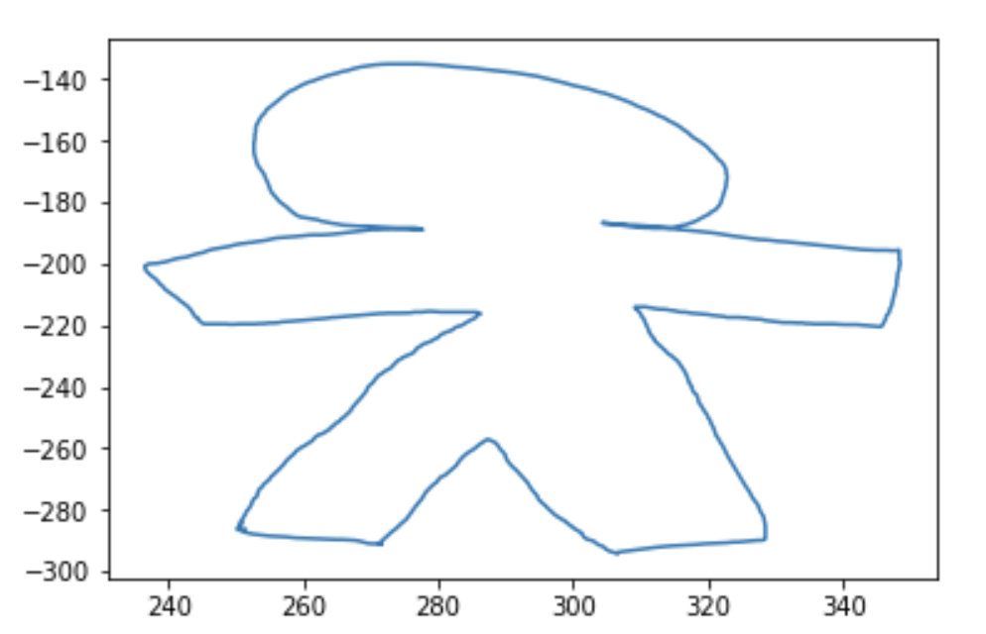
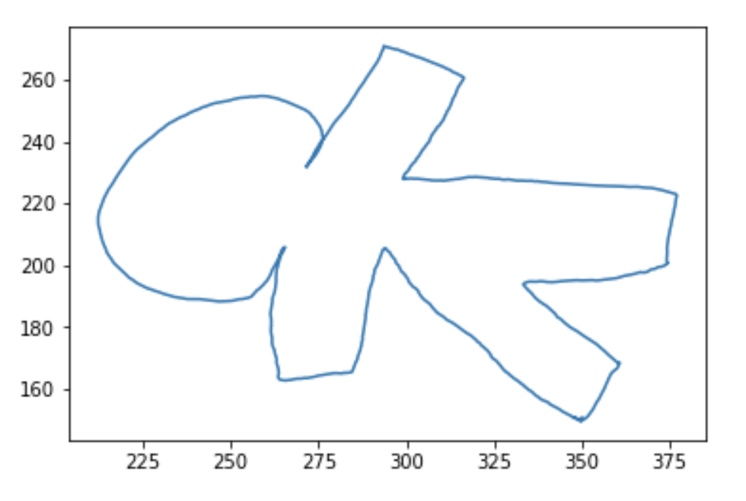
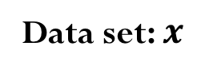
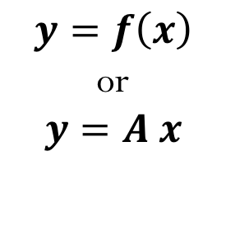
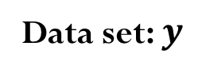
Matrices operating on data
Data set: $x$
Data set: $y$
Rotation
$$y=f\left(x\right)$$
or
$$y=A x$$

Slide 10
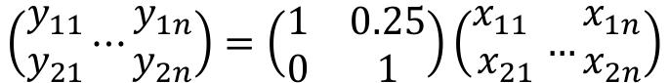
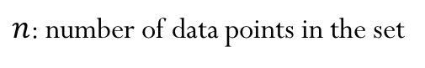
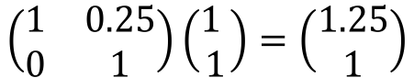
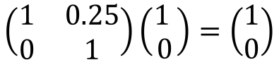
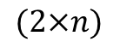
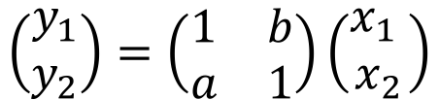
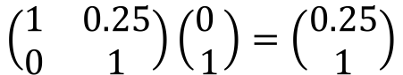
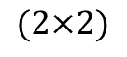
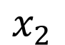
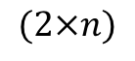
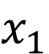
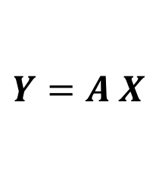
Demo “Matrix transformations”
Example: Shear operator
Matrix-vector multiplication for each vector (point representation in 2D):
$$x_{2}$$
$$\left(\begin{matrix}y_{1} \\ y_{2}\end{matrix}\right)=\left(\begin{matrix}1 & b \\ a & 1\end{matrix}\right)\left(\begin{matrix}x_{1} \\ x_{2}\end{matrix}\right)$$
$$\left(\begin{matrix}1 & 0.25 \\ 0 & 1\end{matrix}\right)\left(\begin{matrix}1 \\ 1\end{matrix}\right)=\left(\begin{matrix}1.25 \\ 1\end{matrix}\right)$$
$$\left(\begin{matrix}1 & 0.25 \\ 0 & 1\end{matrix}\right)\left(\begin{matrix}0 \\ 1\end{matrix}\right)=\left(\begin{matrix}0.25 \\ 1\end{matrix}\right)$$
$$x_{1}$$
$$\left(\begin{matrix}1 & 0.25 \\ 0 & 1\end{matrix}\right)\left(\begin{matrix}1 \\ 0\end{matrix}\right)=\left(\begin{matrix}1 \\ 0\end{matrix}\right)$$
We can do this better…
$$\left(\begin{matrix}y_{11} \\ y_{21}\end{matrix}⋯\begin{matrix}y_{1n} \\ y_{2n}\end{matrix}\right)=\left(\begin{matrix}1 & 0.25 \\ 0 & 1\end{matrix}\right)\left(\begin{matrix}x_{11} \\ x_{21}\end{matrix}…\begin{matrix}x_{1n} \\ x_{2n}\end{matrix}\right)$$
$$Y=A X$$
$$(2×n)$$
$$(2×n)$$
$n$: number of data points in the set
$$(2×2)$$

Slide 11
Matrices as operators
Data: grid of 2D points
Transform the data using matrix multiply
What can matrices do?
Shear
Rotate
Scale
Reflect
Can they translate?

Slide 12
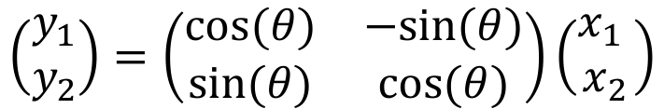
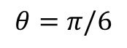
Demo “Matrix transformations”
Rotation operator
$$\left(\begin{matrix}y_{1} \\ y_{2}\end{matrix}\right)=\left(\begin{matrix}cos⁡(θ) & −sin⁡(θ) \\ sin⁡(θ) & cos⁡(θ)\end{matrix}\right)\left(\begin{matrix}x_{1} \\ x_{2}\end{matrix}\right)$$
$$θ=π/6$$

Slide 13
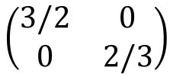
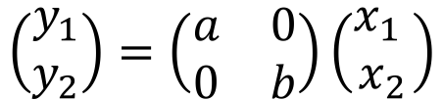
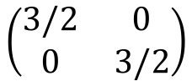
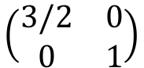
Demo “Matrix transformations”
Scale operator
$$\left(\begin{matrix}y_{1} \\ y_{2}\end{matrix}\right)=\left(\begin{matrix}a & 0 \\ 0 & b\end{matrix}\right)\left(\begin{matrix}x_{1} \\ x_{2}\end{matrix}\right)$$
$$\left(\begin{matrix}3/2 & 0 \\ 0 & 3/2\end{matrix}\right)$$
$$\left(\begin{matrix}3/2 & 0 \\ 0 & 1\end{matrix}\right)$$
$$\left(\begin{matrix}3/2 & 0 \\ 0 & 2/3\end{matrix}\right)$$

Slide 14
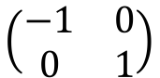
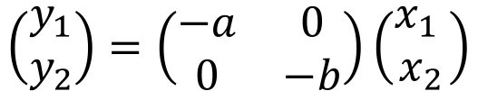
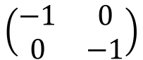
Demo “Matrix transformations”
Reflection operator
$$\left(\begin{matrix}y_{1} \\ y_{2}\end{matrix}\right)=\left(\begin{matrix}−a & 0 \\ 0 & −b\end{matrix}\right)\left(\begin{matrix}x_{1} \\ x_{2}\end{matrix}\right)$$
$$\left(\begin{matrix}−1 & 0 \\ 0 & 1\end{matrix}\right)$$
$$\left(\begin{matrix}−1 & 0 \\ 0 & −1\end{matrix}\right)$$
Reflect about y-axis
Reflect about x and y-axis

Slide 15
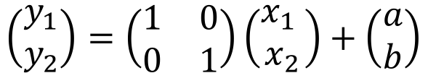
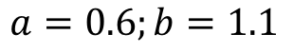
Demo “Matrix transformations”
Translation (shift)
$$\left(\begin{matrix}y_{1} \\ y_{2}\end{matrix}\right)=\left(\begin{matrix}1 & 0 \\ 0 & 1\end{matrix}\right)\left(\begin{matrix}x_{1} \\ x_{2}\end{matrix}\right)+\left(\begin{matrix}a \\ b\end{matrix}\right)$$
$$a=0.6;b=1.1$$

Slide 16


Matrices operating on data
Data set: $A$
Data set: $B$
Rotation
Demo “Matrices for geometry transformation”

Slide 17
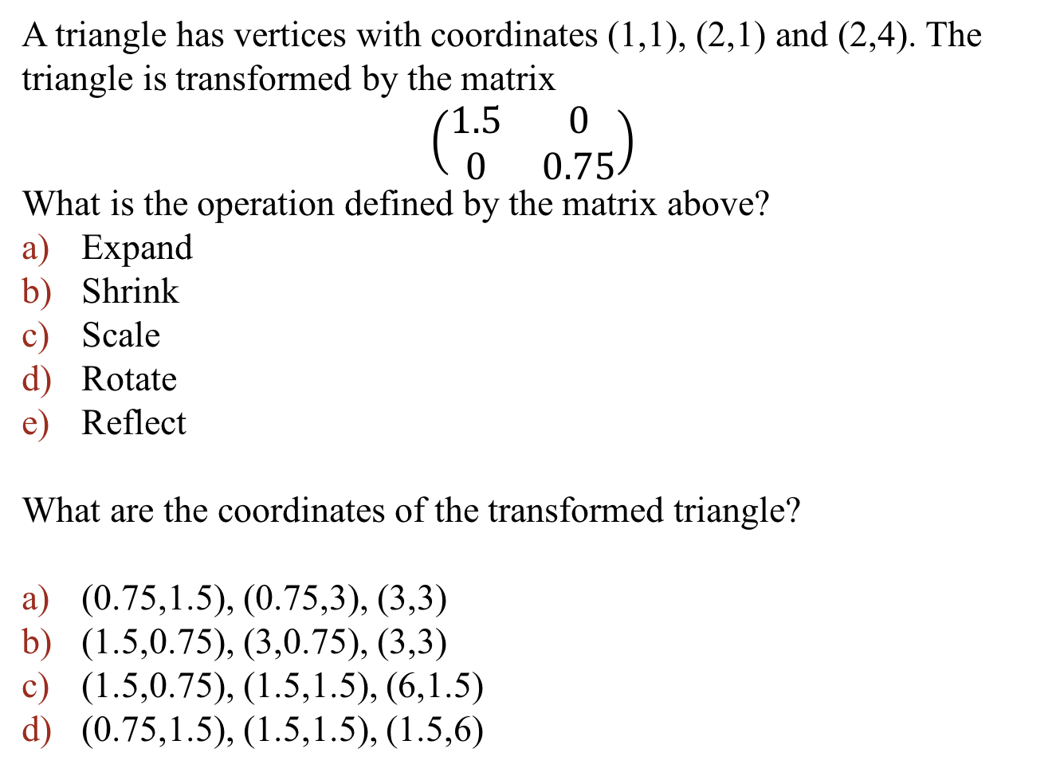
Iclicker question
A triangle has vertices with coordinates (1,1), (2,1) and (2,4). The triangle is transformed by the matrix
$$\left(\begin{matrix}1.5 & 0 \\ 0 & 0.75\end{matrix}\right)$$
What is the operation defined by the matrix above?
Expand
Shrink
Scale
Rotate
Reflect
What are the coordinates of the transformed triangle?
(0.75,1.5), (0.75,3), (3,3)
(1.5,0.75), (3,0.75), (3,3)
(1.5,0.75), (1.5,1.5), (6,1.5)
(0.75,1.5), (1.5,1.5), (1.5,6)

Slide 18
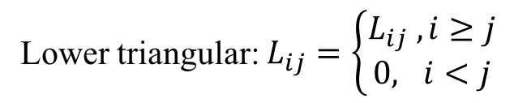
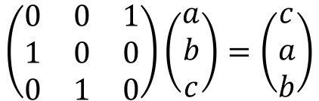
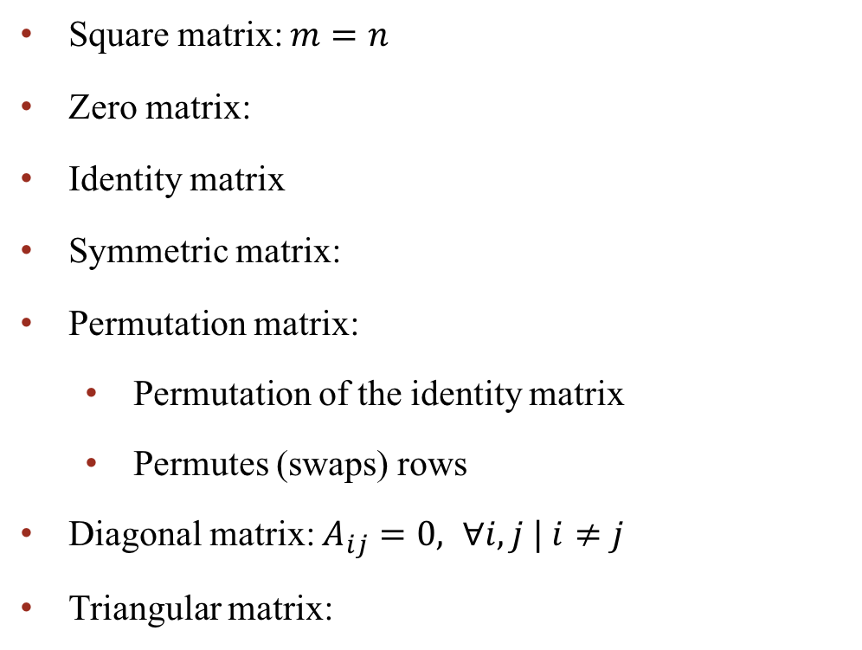
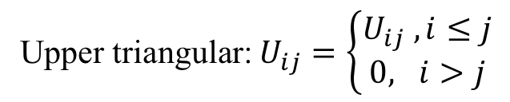
Notation and special matrices
Square matrix: $m=n$
Zero matrix:
Identity matrix
Symmetric matrix:
Permutation matrix:
Permutation of the identity matrix
Permutes (swaps) rows
Diagonal matrix: $A_{ij}=0, ∀i,j | i≠j$
Triangular matrix:
$$\left(\begin{matrix}0 & 0 & 1 \\ 1 & 0 & 0 \\ 0 & 1 & 0\end{matrix}\right)\left(\begin{matrix}a \\ b \\ c\end{matrix}\right)=\left(\begin{matrix}c \\ a \\ b\end{matrix}\right)$$
Lower triangular: $L_{ij}=\left\{\begin{matrix}L_{ij} , i≥j \\ 0, i<j\end{matrix}\right.$
Upper triangular: $U_{ij}=\left\{\begin{matrix}U_{ij} , i≤j \\ 0, i>j\end{matrix}\right.$

Slide 19
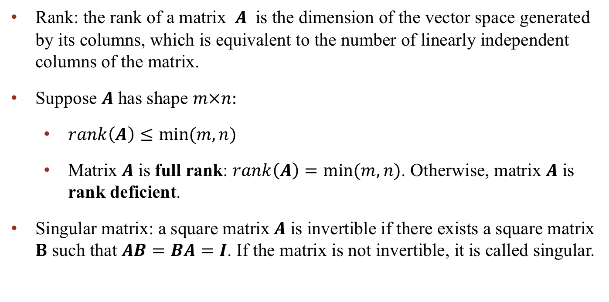
More about matrices
Rank: the rank of a matrix $A$ is the dimension of the vector space generated by its columns, which is equivalent to the number of linearly independent columns of the matrix.
Suppose $A$ has shape $m×n:$
$rank\left(A\right)≤min⁡(m,n)$
Matrix $A$ is full rank: $rank\left(A\right)=min⁡(m,n)$. Otherwise, matrix $A$ is rank deficient.
Singular matrix: a square matrix$A$ is invertible if there exists a square matrix $B$ such that $AB=BA=I$. If the matrix is not invertible, it is called singular.

Slide 20
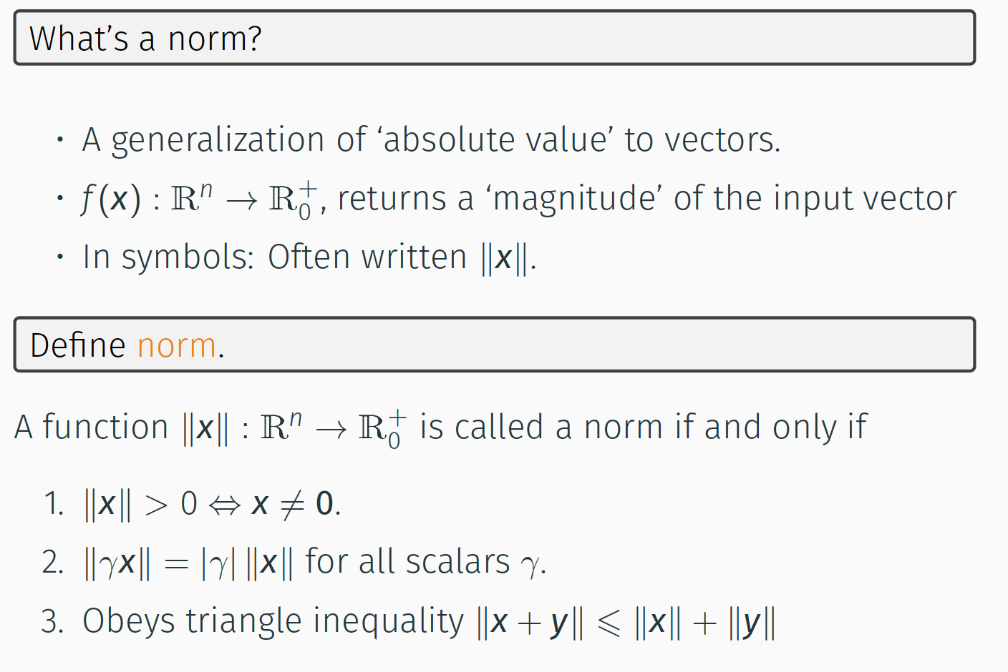
Norms

Slide 21
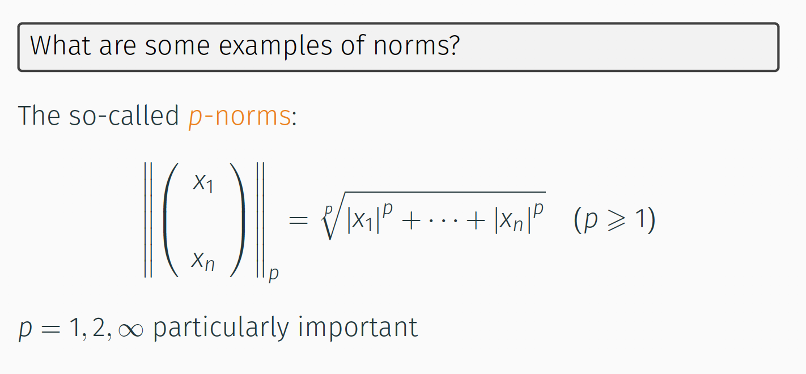
Demo “Vector Norms”
Example of Norms

Slide 22
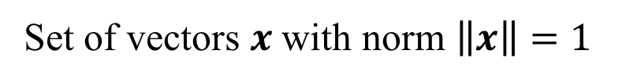
Unit Ball:
Set of vectors $x$ with norm $\left\|x\right\|=1$
Demo “Vector Norms”

Slide 23





Why should be $p≥1$ when calculating the p-norm?
$$x_{2}$$
$$(0,1)$$
$$(1,0)$$
$$x_{1}$$

Slide 24

Iclicker question
a)
b)
c)
d)
e)
Notes:
e)

Slide 25

Norms and Errors

Slide 26


Absolute and Relative Errors
Absolute error:
a) 0.2240
b) 0.3380
c) 0.2513
Relative error:
a) $2.59{×10}^{−3}$
b) $2.81{×10}^{−3}$
Notes:
C and A

Slide 27

Matrix Norms

Slide 28


Matrix Norms

Slide 29


Matrix Norms

Slide 30






Induced Matrix Norms
Given the matrix $A$with $m$ rows and $n$ columns:
$${\left\|A\right\|}_{1}=\max_{j}{\sum_{i=1}^{m}{\left|A_{ij}\right|}}$$
Maximum absolute column sum of the matrix $A$
$${\left\|A\right\|}_{∞}=\max_{i}{\sum_{j=1}^{n}{\left|A_{ij}\right|}}$$
Maximum absolute row sum of the matrix $A$
$${\left\|A\right\|}_{2}=\max_{k}{σ_{k}}$$
$σ_{k}$ are the singular value of the matrix $A$

Slide 31

Properties of Matrix Norms
Demo “Matrix Norms”

Slide 32


Iclicker question
Determine the norm of the following matrices:
1)
2)
a) 3
b) 4
c) 5
d) 6
e) 7
Notes:
7
6

Slide 33

Iclicker question
a) 90
b) 30
c) 20
d) 10
e) 5

Slide 34


Slide 35


